Slide 1
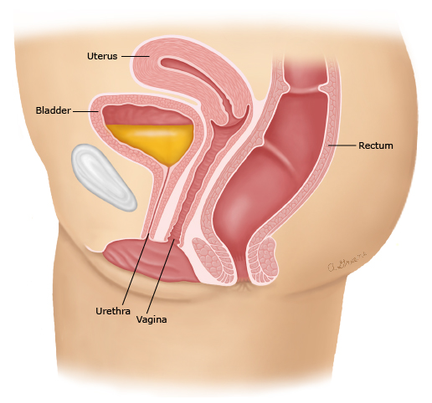
Clinical evaluation of the lower urinary tract
Khadijeh Adabi, Associated Professor, Division of Female Pelvic Medicine and Surgery, Department of obstetrics and Gynecology, Yas Hospital complex, Tehran University of Medical Sciences, Tehran, Iran.

Slide 2
Contents
INTRODUCTION
1
FOCUSED HISTORY AND PHYSICAL EXAMINATION
2
URODYNAMIC EVALUATION and LOWER URINARY TRACT SYMPTOMS TERMINOLOGY
3

Slide 3
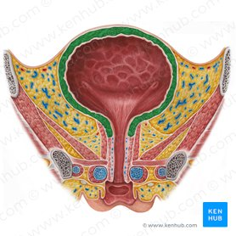
INTRODUCTION
The bladder and the urethra comprise the lower urinary tract and act as a single (vesicourethral) unit during normal lower urinary tract function. The ultimate role of this unit is two main functions:
•to store urine (storage)
•to efficiently empty urine (voiding).

Slide 4
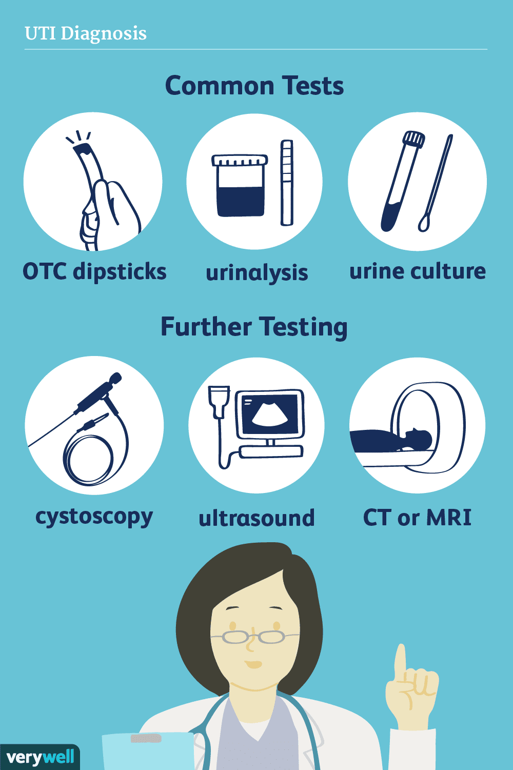
Management of lower urinary tract dysfunction is based on the findings of:
• A detailed history and focused physical examination
• Appropriate laboratory studies
• Endoscopy and radiography to provide structural information when clinically indicated
• Urodynamic studies to provide functional information when clinically indicated

Slide 5
2. FOCUSED HISTORY AND PHYSICAL EXAMINATION

Slide 6
FOCUSED HISTORY AND PHYSICAL EXAMINATION
First and foremost, an appropriately focused clinical history of the patient’s symptoms allows the formation of a working diagnosis, which can help to direct specific clinical questions and subsequent investigations and management.
It is recommended that only standardized terminology be used when describing LUTS.

Slide 7
The ICS has broadly categorized LUTS into three groups related to their timing within the bladder (voiding) cycle.
The three stages of the bladder cycle are:
1. Storage – during which passive filling of the bladder occurs
2. Voiding – during which the vesicourethral unit actively expels the bladder contents
3. Post-micturition – immediately after a voiding phase, when the bladder returns to a storage function

Slide 8
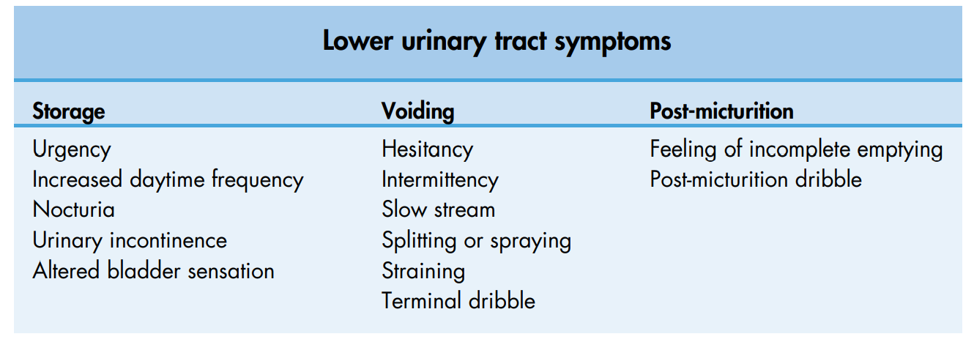

Slide 9
The bladder is frequently said to be an ‘unreliable witness’.
LUTS are not disease specific, and diverse pathophysiological processes can produce overlapping LUTS.
Patients express symptoms in different ways, and this is influenced both by what they are experiencing and how they interpret these symptoms.
Clinicians perform a clinical assessment differently and interpret the clinical picture based on our own experience and prejudices.

Slide 10
Clearly, however, a careful history with emphasis on allocating symptoms to the appropriate stage of the bladder cycle is an important starting point.
Failure to store urine can be due to overactivity of the bladder, underactivity of the bladder with overflow or weakness of the bladder outlet.
Likewise, although voiding symptoms tend to be associated in many people’s minds with bladder outflow obstruction (BOO), they can also occur in the context of inefficient bladder emptying.

Slide 11
After taking a careful history and carrying out an appropriate clinical examination, laboratory, endoscopic or radiographic tests should be performed prior to urodynamic assessment as clinically indicated.

Slide 12
Urodynamics is particularly of benefit in objectively identifying functional abnormalities of the lower urinary tract, such as those of urinary incontinence and BOO.
However (particularly with video cystometry), it may also assist in identifying structural abnormalities, such as a prolapse associated with stress urinary incontinence (SUI), vesicovaginal fistulae, urethral diverticula or upper tract vesicoureteric reflux
In the context of the male patient, it can be useful in demonstrating attenuation of the prostatic urethra in association with prostatic outlet obstruction or confirming the diagnosis of bladder neck obstruction.

Slide 13
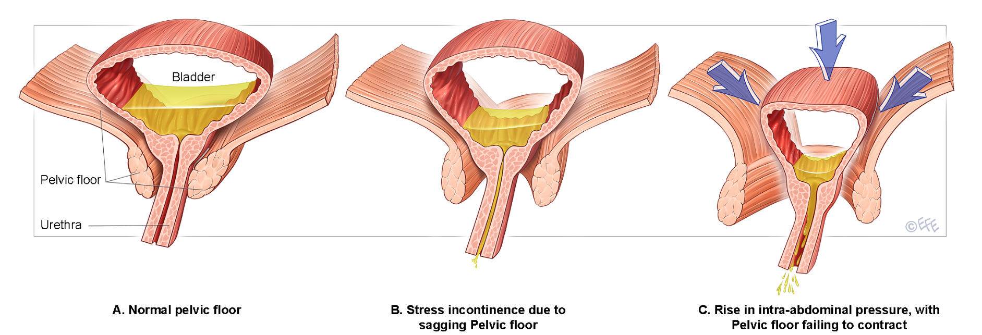
The term urodynamics encompasses any investigation of lower urinary
tract dysfunction from the simple to the sophisticated, including:
•frequency/volume chart (FVC)
• bladder diary
• pad testing
• uroflowmetry
• pressure/flow studies:
❍ cystometry
❍ video cystometry
❍ ambulatory urodynamics
• urethral pressure studies
• other studies:
❍ intravenous urodynamogram
❍ ultrasound cystodynamogram.

Slide 16
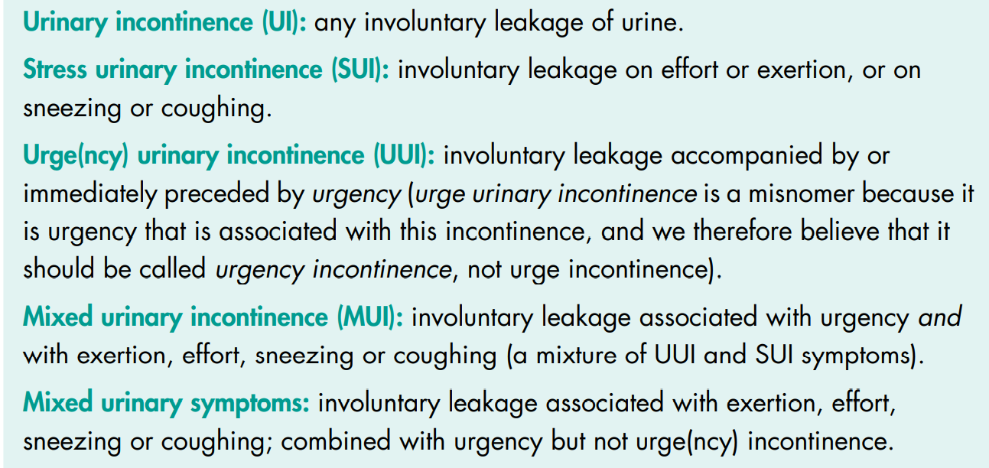

Slide 18
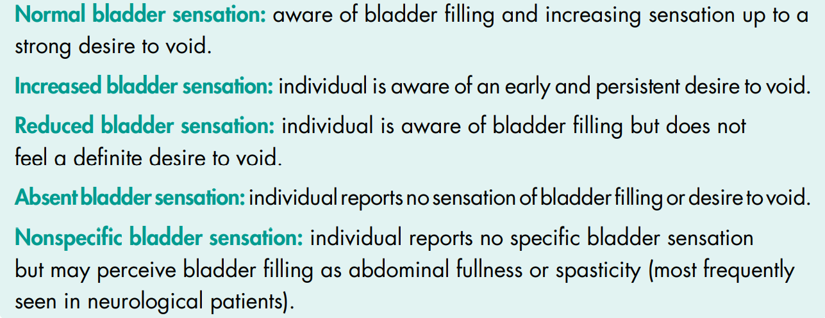

Slide 19
First filling sensation (50 mL);
First desire to void (150 mL);
Strong desire to void (250 mL),
Maximum cystometric capacity (400 mL).

Slide 20
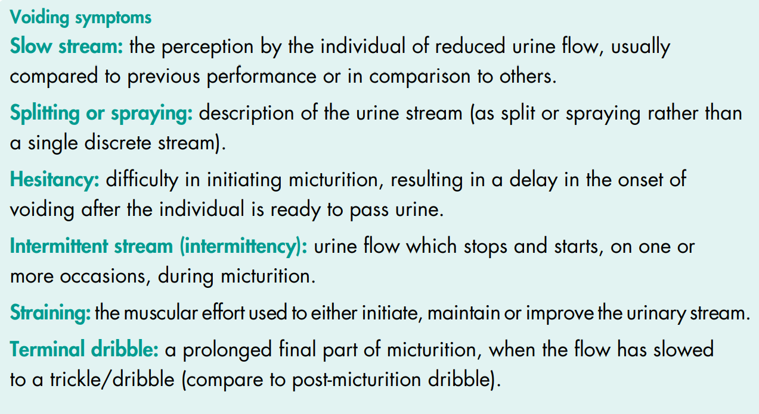

Slide 22
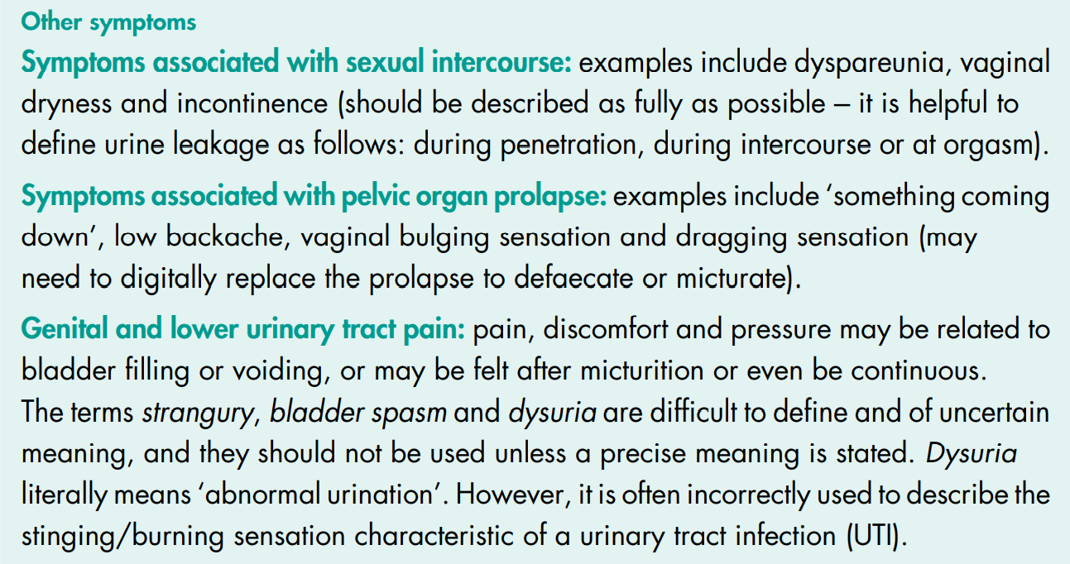

Slide 23
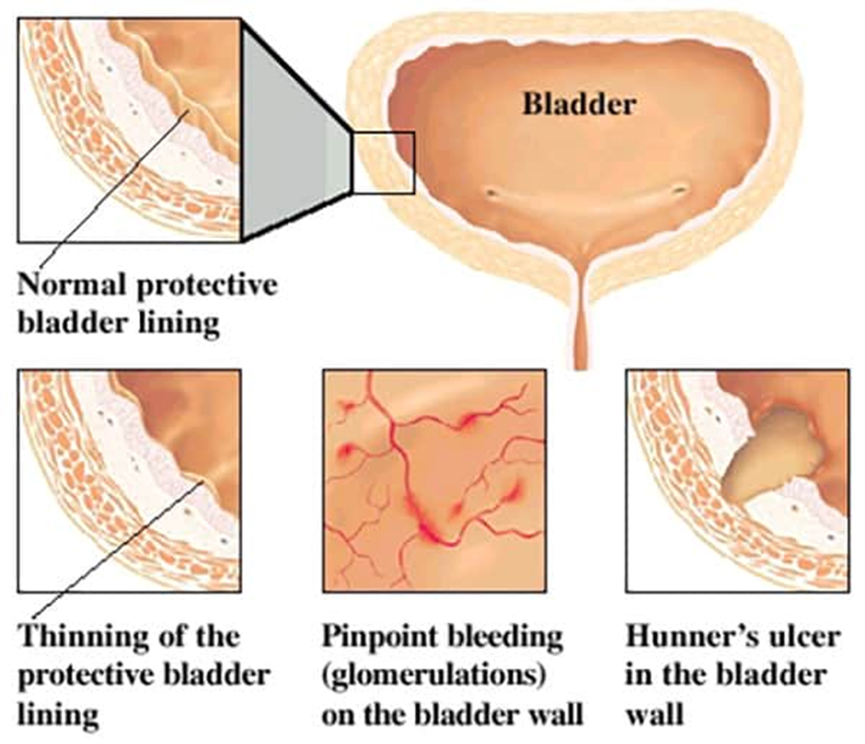

Slide 24
